Slide 1
Safety Moments
From H&P HSE

Slide 2
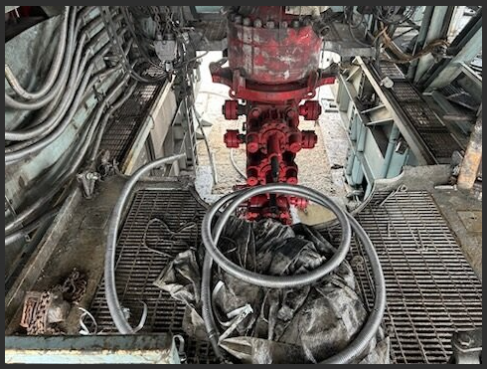
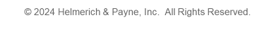
®
Working Near Unprotected Edges
An unprotected/ exposed edge is a boundary or limit of a surface, platform, or structure where there is no protective barrier, such as a guardrail or wall to prevent a person from accidentally stepping or falling over the edge. This can include edges of roofs, floors, scaffolding, elevated work platforms, and other elevated surfaces.
Working near unprotected edges presents significant risks, and it's crucial to implement safety measures to prevent accidents and injuries. Here are some key factors to consider:
Personal Protective Equipment (PPE)
Fall Protection Systems
Training & Awareness
Hazard Assessment
Clear Signage & Barricades
Housekeeping
Buddy System
Emergency Preparedness
Regular Inspections
Communication

Slide 3
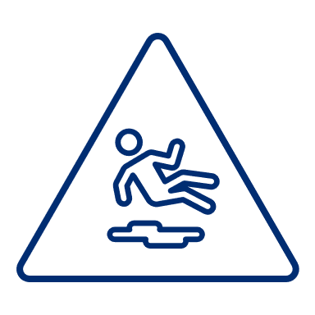
®
Falls From Heights
Falls are one of our greatest exposures in O&G and can have life altering implications. Have you shared the importance of being tied off when at heights or what actions to take if they see someone fall?
PPE
  Ensure that all workers wear appropriate PPE, such as hard hats, safety harnesses, and non-slip footwear.
Fall Protection Systems
  Use guardrails, safety nets, or personal fall arrest systems to protect workers from falling. Ensure that these systems are properly installed and maintained.
Training & Awareness
  Provide comprehensive training to workers about the hazards of working near unprotected edges and the importance of using fall protection systems. Regularly conduct safety briefings and refreshers.
Hazard Assessment
  Conduct a thorough hazard assessment before starting any work near unprotected edges. Identify potential risks and implement control measures to mitigate them.
Clear Signage & Barricades
  Use clear signage to warn workers of unprotected edges. Install barricades or temporary guardrails to restrict access to hazardous areas.

Slide 4

®
Falls From Heights
Falls are one of our greatest exposures in O&G and can have life altering implications. Have you shared the importance of being tied off when at heights or what actions to take if they see someone fall?
Housekeeping
  Keep the work area clean and free of debris that could cause trips or falls. Ensure that tools and materials are properly stored and do not pose a tripping hazard.
Buddy System
  Encourage the use of a buddy system where workers look out for each other and ensure that no one is working alone near unprotected edges.
Emergency Preparedness
  Have a clear emergency plan in place, including procedures for rescue operations in case of a fall. Ensure that all workers are familiar with the emergency plan and know how to respond.
Regular Inspections
  Conduct regular inspections of the work area and fall protection systems to ensure they are in good condition and functioning properly.
Communication
  Maintain open lines of communication among all workers and supervisors. Encourage workers to report any hazards or unsafe conditions immediately.

Slide 5
®
REMEMBER
Any work performed at a height over 4’ should be considered “working at heights” and requires 100% tie off.
By keeping fall prevention and protection at the forefront of your mind, you can significantly reduce the risk of accidents and ensure a safer working environment.

