Slide 1
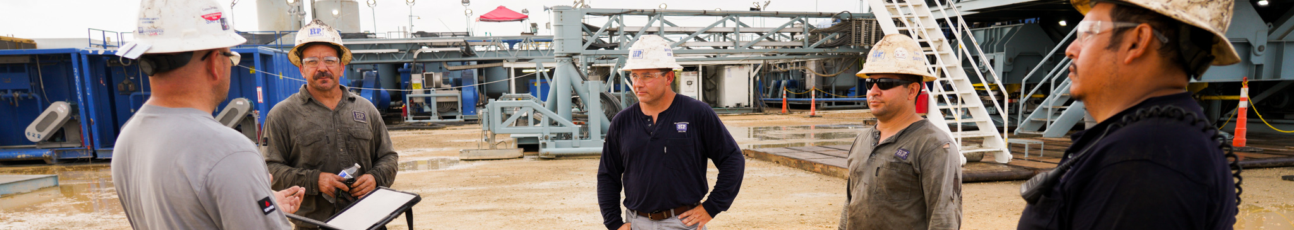
®
Pre-Tour
Beginning of
Pre-Job Planning
Safety
Discussions
Team
Initial Problem Solving
Current operations are explained to oncoming crew, priorities and expectations are explained. Ongoing or possible issues and difficulties should be discussed, and plans made to overcome and complete operations successfully.
Initial safety protocols are discussed including known hazards and SIF potentials. Highlight HSE Standards and Guidelines to make sure compliance requirements are met.
Time for every member of the crew to understand their upcoming roles and responsibilities and make sure everyone is on the same page
Come up with a good game plan and discuss previous issues when performing the same operations.

Slide 2
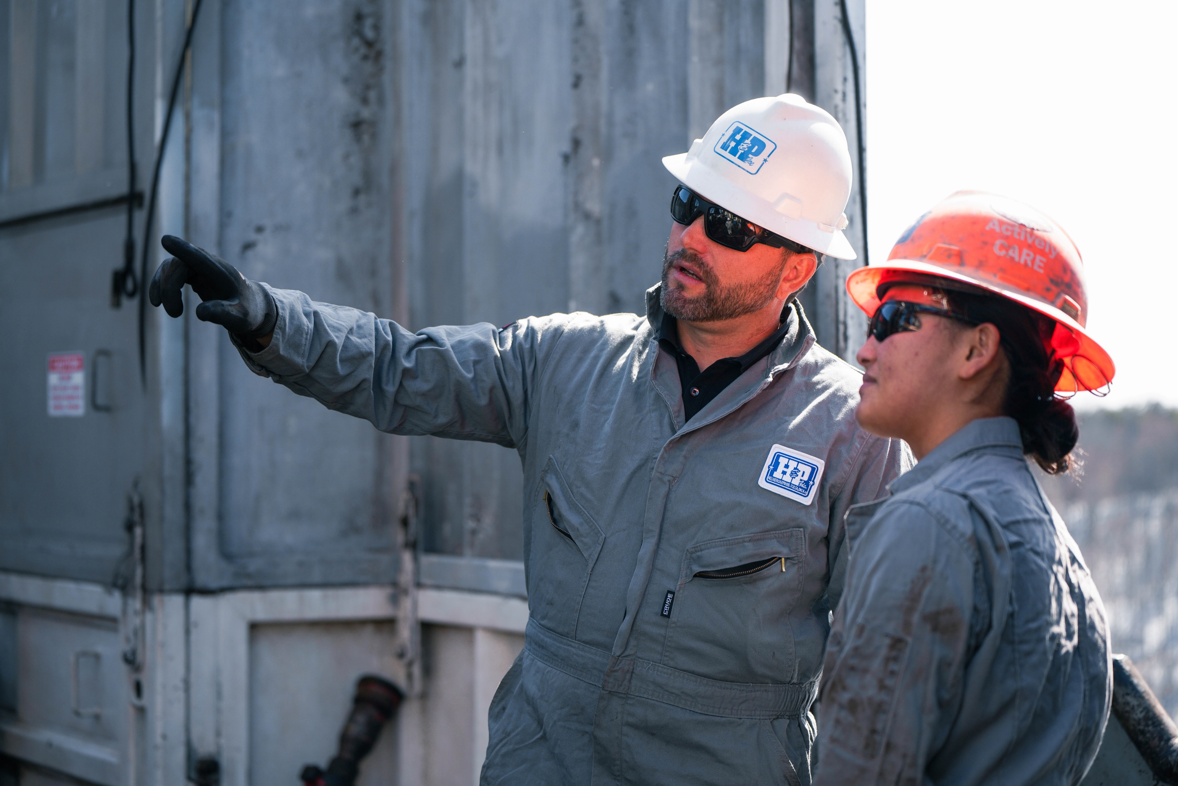
®
Making a Good Relief
Good Transition
Accountability
Efficiency
Team Player
A complete and honest relief prevents disruptions in operations.
This ensures that responsibilities are properly transferred and reduces the possibility of overlooking certain task that could possibly turn into a SIF potential.
Allows the oncoming hands to save time and continue operations safely, by providing them with a clear outline of what needs to be done.
Shows your commitment to keeping the operations at a high standard and it shows respect to your relief.

Slide 3
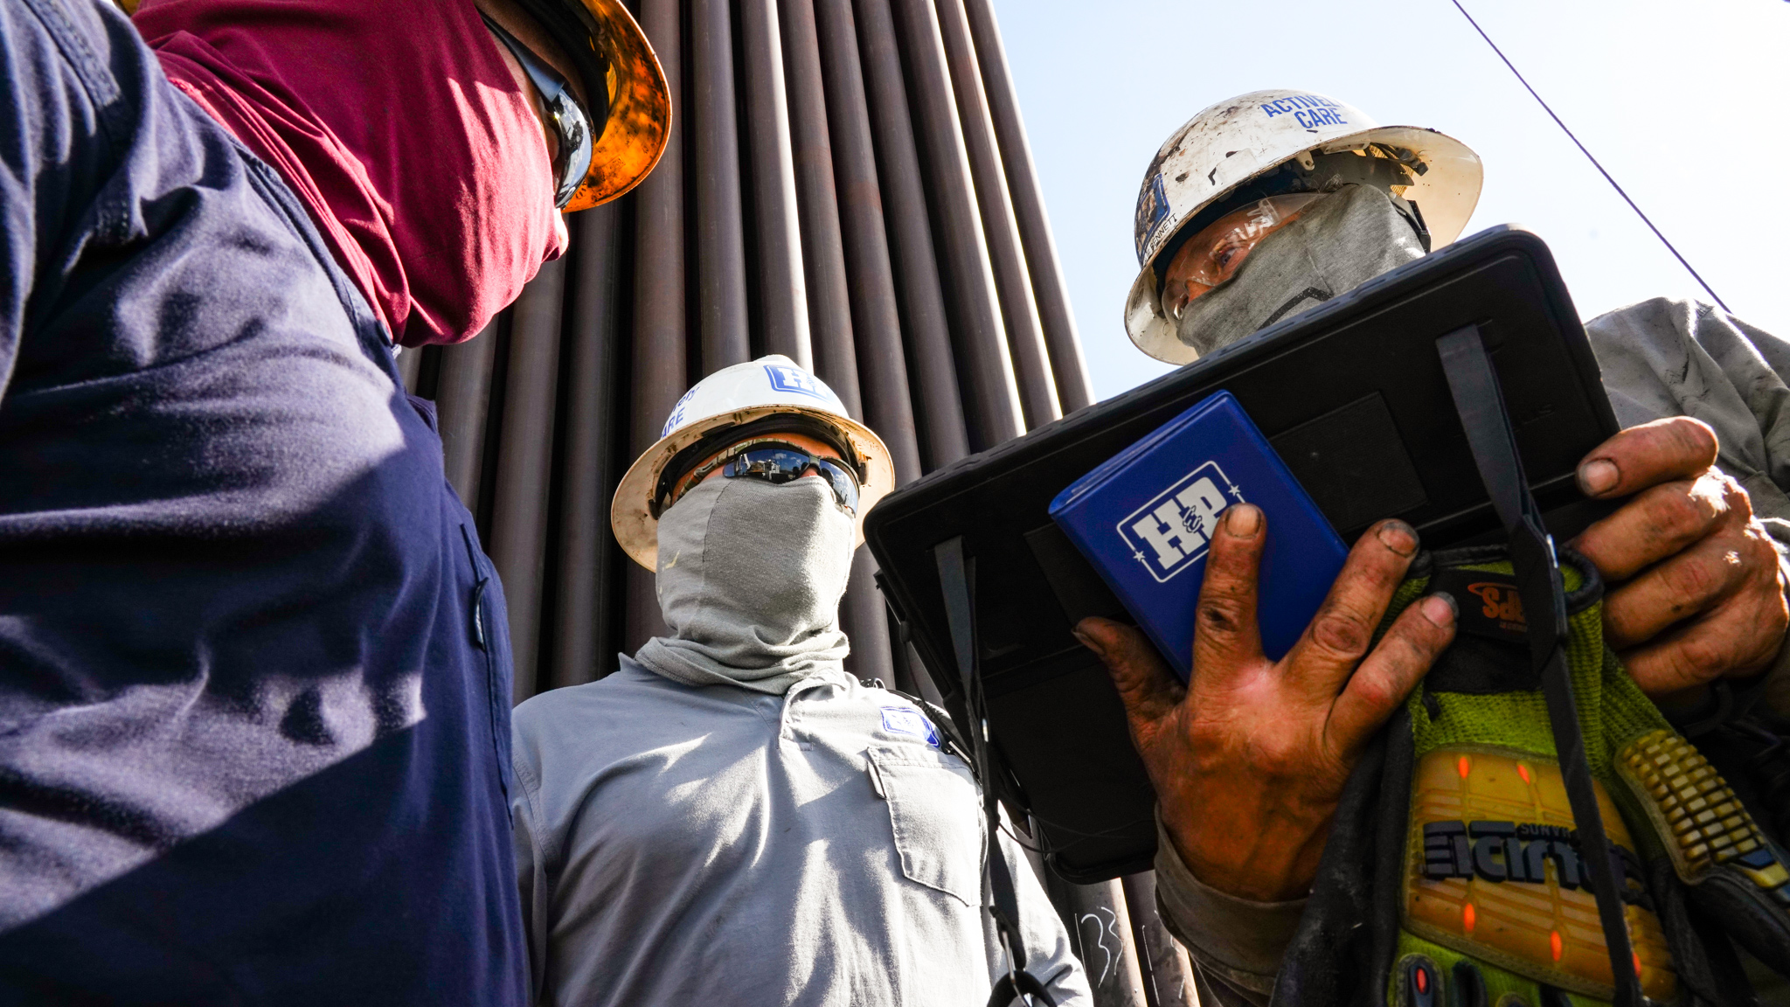
®
Handover Notes
Documents Important Information
Reference
Shows tasks completed, ongoing issues, upcoming operations, and deadlines. Creates smooth transition of continued operations.
Allows relief to refer to previous events or situations that may arise. Communicates important details, in case of miscommunicated during verbal relief.

Slide 4

®
REMEMBER
These three elements are crucial for a team to maintain efficiency, ensure continuous operations, minimize risks, and, most importantly, complete tasks safely.
They are not only essential components of
pre-job planning but also set up your relief,
team, and company for success

