Slide 1
Safety Moments
From H&P HSE

Slide 2

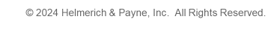
™
Fire Safety
The most important part of fire safety is preventing a fire from happening in the first place
Fires can pose a significant threat both at work and at home. It’s important to treat fire with respect no matter where you are
Stay prepared for fires by early detection and by knowing the type of fire you’re dealing with
Remember: Fire prevention starts with you! You should always follow established procedures, maintain equipment, and remain prepared.

Slide 3
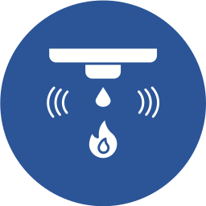
Fire Safety
Smoke detectors
Smoke detectors assist with early detection of fires
Smoke detectors should have their batteries replaced routinely, about every 6 months to a year
Smoke detectors should be tested frequently to ensure the alarm is working properly
It is important to make sure everyone understands and is familiar with the sound of the smoke alarm and knows how to respond
Remember: A fire can start anywhere! Installing smoke detectors in all areas of your home ensures you are promptly alerted.

Slide 4
Fire Classes
In order to extinguish a fire, it’s important to understand the type of fire you’re fighting.
Fires are classified according to the type of fuel being burned. There are five classes of fires:
The class of a fire determines how quickly it burns, how dangerous it is, and the best way to put the fire out.
CLASS A
CLASS B
CLASS C
B
C
A
CLASS D
CLASS K
D
K

Slide 5
Fire Classes
Class A Fire
Class A fires are fires fueled by ordinary combustibles such as wood, paper, cloth, rubber, or plastic
Be sure to use the appropriate fire extinguisher for a Class A fire – Type A or ABC
A

Slide 6
Fire Classes
Class B Fire
Class B fires are fires fueled by flammable or combustible gases and liquids such as gasoline, grease, diesel, kerosene, paint, paint thinners, propane, or natural gas
These fires are best extinguished by smothering
Be sure to use the appropriate fire extinguisher for a Class B fire – Type ABC, BC
B

Slide 7
Fire Classes
Class C Fire
Class C fires are fires energized by electrical equipment such as appliances, switches, or power tools
Do NOT use water to fight Class C fires – this can increase likelihood of electrocution
Be sure to use the appropriate fire extinguisher for a Class C fire – Type ABC, BC
C

Slide 8
Fire Classes
Class D Fire
D
Class D fires are fires that involve certain combustible metals such as magnesium, titanium, potassium, or sodium
When it comes to a metal-based fire, you should never use water to fight the fire
Be sure to use the appropriate fire extinguisher for a Class D fire – Type ABC

Slide 9
Fire Classes
Class K Fire
Class K fires are fires that involve cooking oils, fats, and animal oils, which are commonly found in kitchens
Be sure to use the appropriate fire extinguisher for a Class K fire – Type K
K

Slide 10
Fire Extinguishers
Fire Extinguisher Classifications
There are four main types of fire extinguishers:
Similar to there being different fire classes, fire extinguishers also have different classifications
Using the wrong type of fire extinguisher may cause electrical shock, explosion, or spread the fire, so it is important to know which extinguisher type to use
WATER
DRY POWDER
Type A
Type ABC
CO2
WET CHEMICAL
Type BC
Type K
Please Note: The color code for fire extinguishers do NOT coincide with the color code for fire classification

Slide 11

Fire Extinguishers
Type A Fire Extinguisher
WATER
Symbols:
Type A fire extinguishers use pressurized water, and can only be used on Class A fires
Do not use on Class B or C fires – this may cause the fire to spread or electrical shock
A

Slide 12


Fire Extinguishers
Type ABC Fire Extinguisher
DRY POWDER
Symbols:
Type ABC fire extinguishers use a dry chemical, and can be used on ALL fire classes
The ABC Type Fire Extinguisher is the most common type found on H&P rigs
These types of fire extinguishers can be very corrosive to electronics, and should only be used on electronics when there are no other extinguishers available, and when there is imminent danger to personnel or property
A
B
C

Slide 13
Fire Extinguishers
Type BC Fire Extinguisher
CO2
Symbols:
Type BC fire extinguishers use CO2, and can be used on Class B and C fires
CO2 extinguishers leave behind no harmful residue, making it a good choice for an electrical fire
B
C

Slide 14

Fire Extinguishers
Type K Fire Extinguisher
WET CHEMICAL
Symbols:
Type K fire extinguishers use a wet chemical and are best used for fires involving cooking oils and fats, which are commonly found in kitchens
K

Slide 15
Fire Extinguishers
How To Use A Fire Extinguisher
P
An easy way to remember how to properly use a fire extinguisher is by remembering the PASS acronym
Pull the pin
A
Aim the nozzle to the base of the fire
S
Squeeze the lever slowly
S
Sweep the nozzle from side to side at the base of the fire

Slide 16
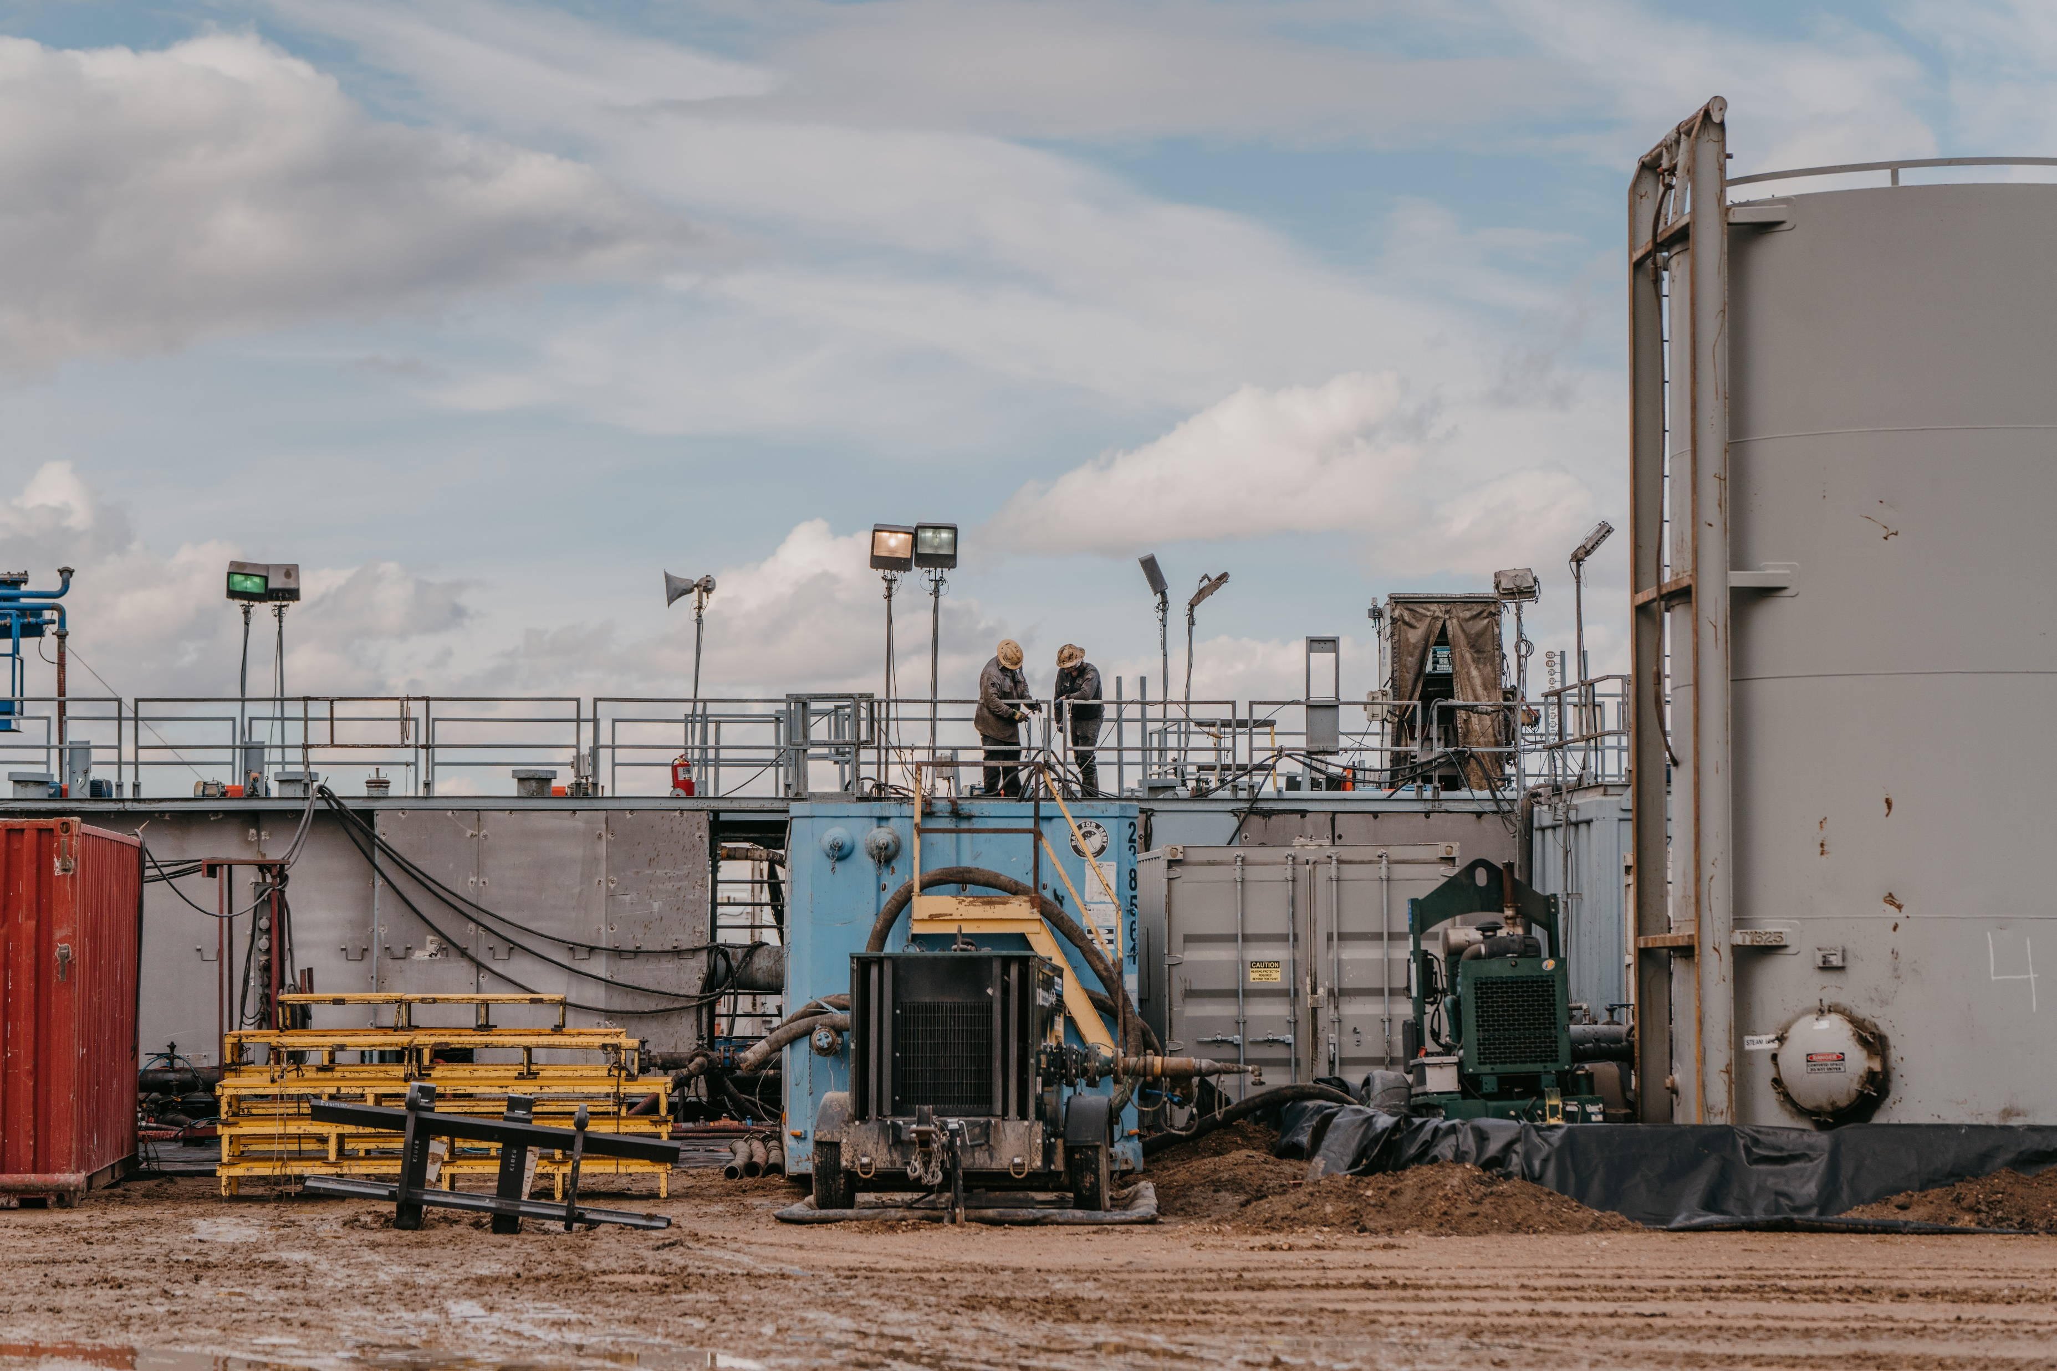
™
Rig Fire Safety
Fire prevention requires the control or removal of potential fuel sources on the drill site. It’s important to identify these sources, establish controls, and evaluate their operation for potential fire hazards.
Examples of common fuel sources in drilling operations include but are not limited to:
Crude oil and gases from the well bore
Diesel fuel
Paints and solvents
Mud mixing products
Compressed gases
Oil soaked rags and clothing
Generators
Electric motors and electrical wiring

Slide 17
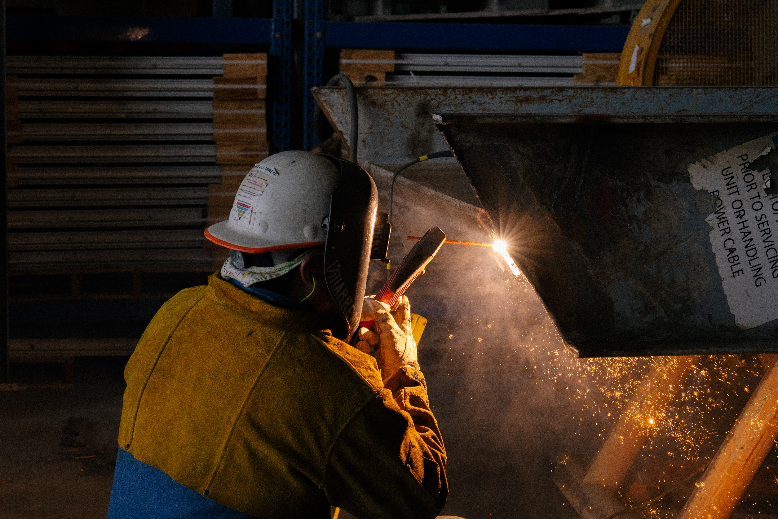
™
Rig Fire Safety
Fire prevention requires the control or removal of potential ignition sources on the drill site. It’s important to identify these sources, establish controls, and evaluate their operation for potential fire hazards.
Examples of common ignition sources in drilling operations include but are not limited to:
Open flame, arcs, sparks, and slag
Faulty or damaged cords and devices
Barbecue grills
Cigarettes, lighters, or matches
  Remember: Always smoke in designated smoking areas and dispose of your extinguished cigarettes in a butt can
Vehicles or combustion engines

Slide 18
™
Rig Fire Safety
Establishing controls is important for fire prevention on the rig. Here are a few hazard control methods:
1. Mechanical Controls
3. Safety Standards and Trainings
Use valves, piping, and passive detection equipment like fixed gas protectors to control hazards mechanically
Establish safety standards through training and education
Apply formal work procedures such as hot work permits and job safety analyses (JSAs) to manage operations with potential fire or explosion risks
2. Signage and Warning
4. Communication and Approval
Post signs and warnings in high hazard areas to alert personnel to surrounding risks
Implement audible and visual alarm systems to initiate quick responses to incidents
Ensure thorough communication of work intentions among all parties
Obtain the necessary approvals for permitted work

Slide 19
REMEMBER
The most important part of fire safety is preventing a fire from happening in the first place
Being able to identify what type of fire you’re dealing with and knowing what the right extinguishing method to use ensures a faster and more effective response
Know what the potential fuel and ignition sources are on the rig site
Establish and maintain proper hazard control methods

Slide 20
References
https://www.uclahealth.org/safety/ambulatory-safety/ambulatory-fire-and-life-safety-program/classes-fires-fire-extinguishers
https://www.nfpa.org/news-blogs-and-articles/blogs/2023/08/01/fire-extinguisher-types
https://sequatchievolfiredepartment.weebly.com/fire-extinguishers.html

